Slide 1
Scoil Teampall Toinne Discover Primary Science and Maths Award of Excellence Application (Plaque) SFI Application Code: 2019/DSM/298 Six teacher school

Slide 2
Step One:
Science

Slide 3
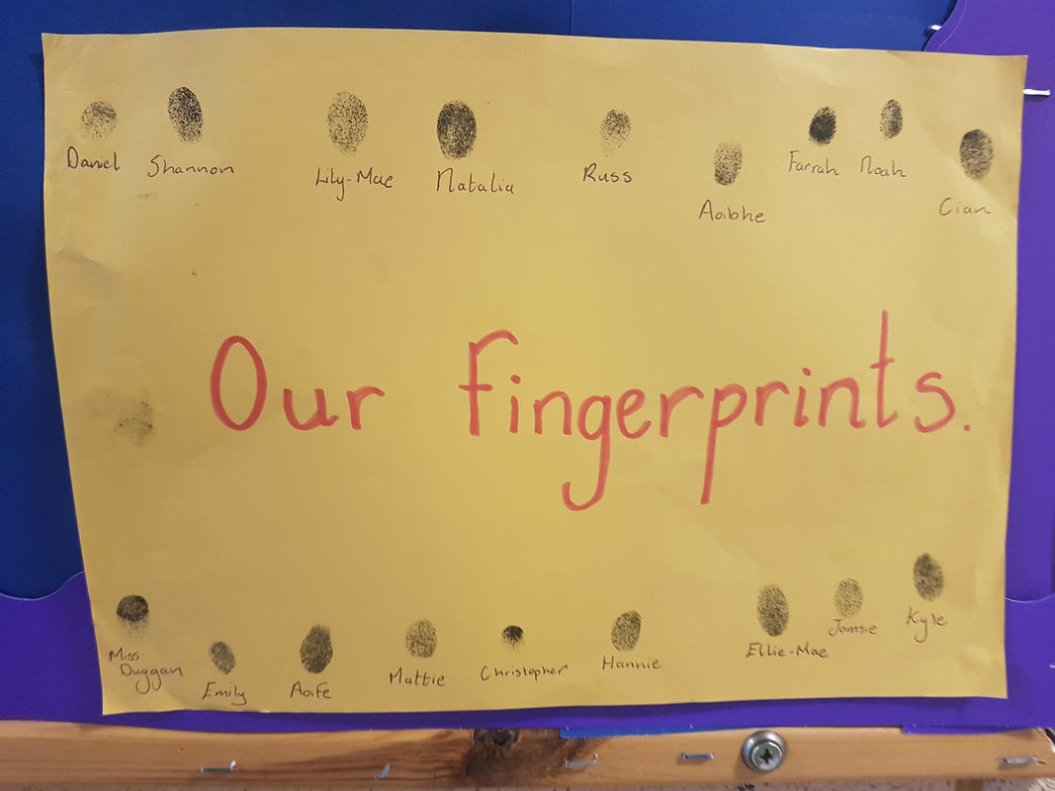
Living things:
The Junior Infants have spent much time learning new things this year. Something very exciting that they have learned is that every one of us is unique. So unique in fact that we all have our very own fingerprints. No two peoples’ fingerprints are the exact same. Take a look at our fingerprints.

Slide 4
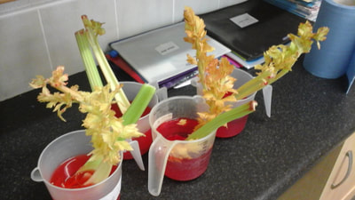
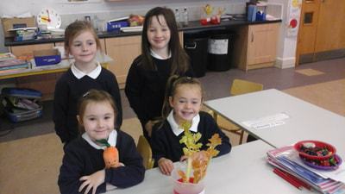
In Senior Infants, we investigated how plants drink by pouring some red dye and water into a jug of celery. We left it overnight and in the morning the leaves had turned red.

Slide 5
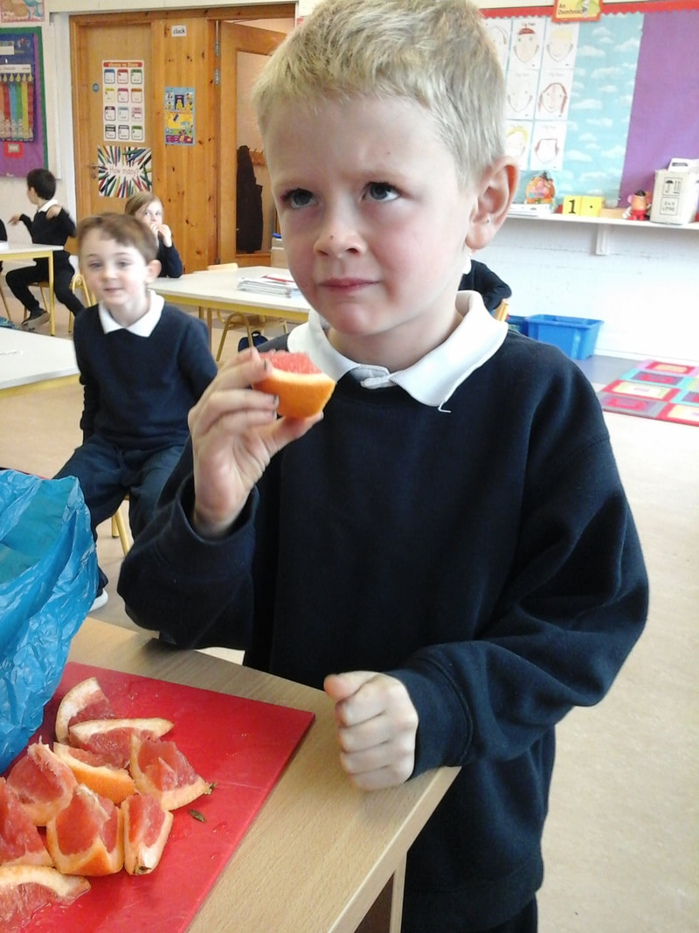
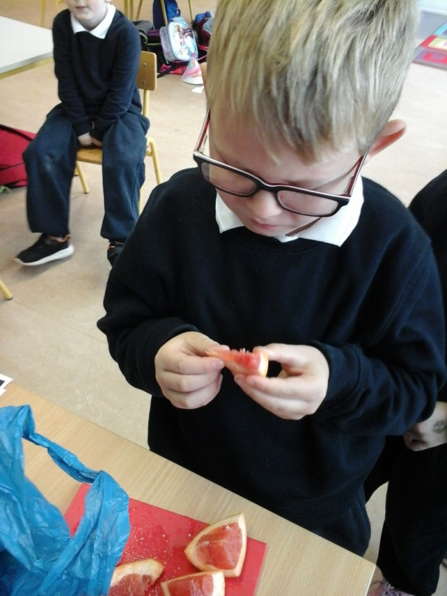
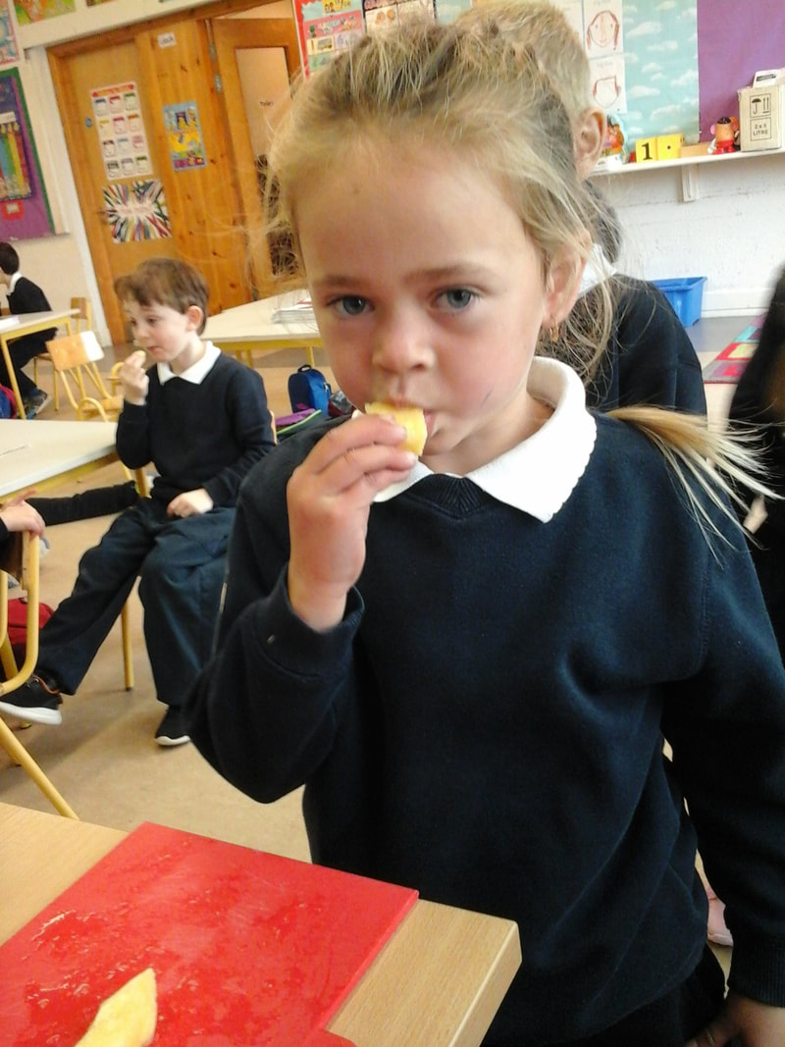
Oh bitter! The children in Infants learned all about healthy eating and foods that help us to grow. They learned about our five senses and they used their taste sense to taste various foods to compare sweet with bitter flavours.

Slide 6
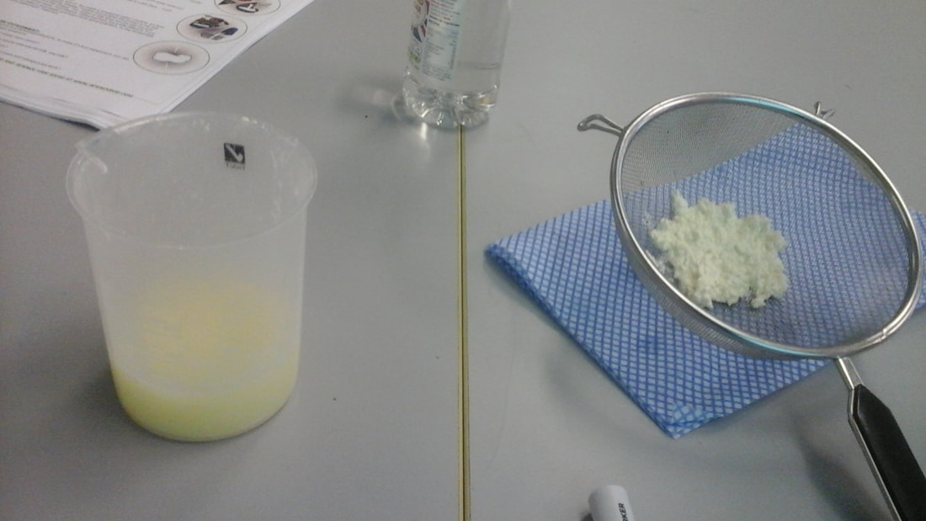
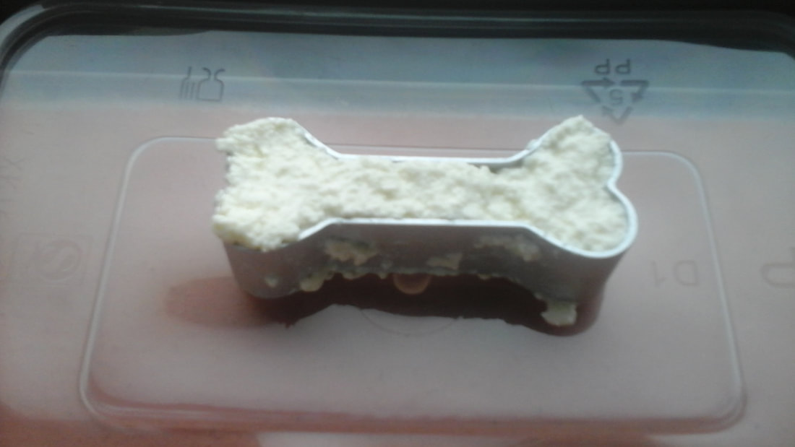
The children in 3rd and 4th class couldn’t believe they made their very own bones!
The children made bones from milk..... We made a substance called CASEIN. It’s from the Latin word meaning “cheese.” Casein occurs when the protein in the milk meets the acid in the vinegar. The casein in milk does not mix with the acid and so it forms blobs or solids.

Slide 7
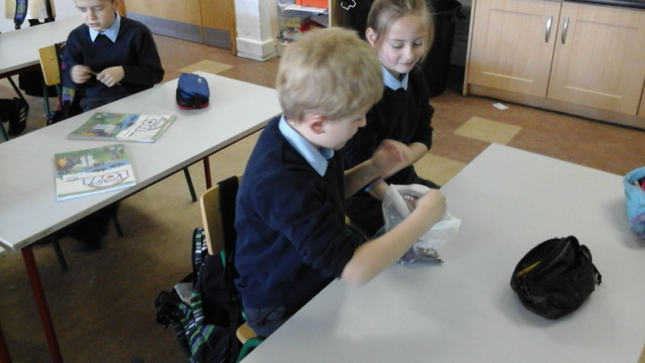
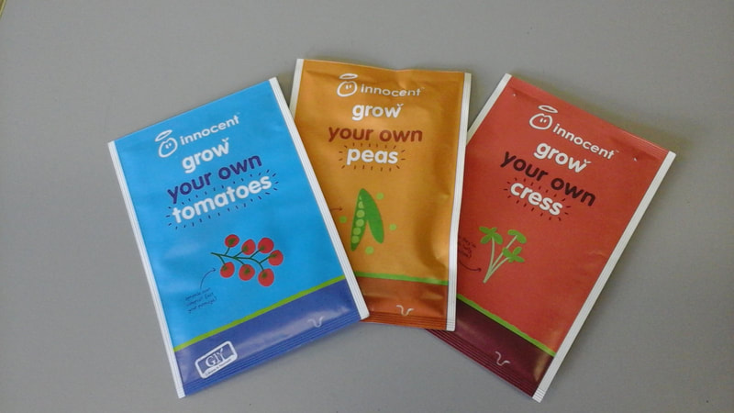
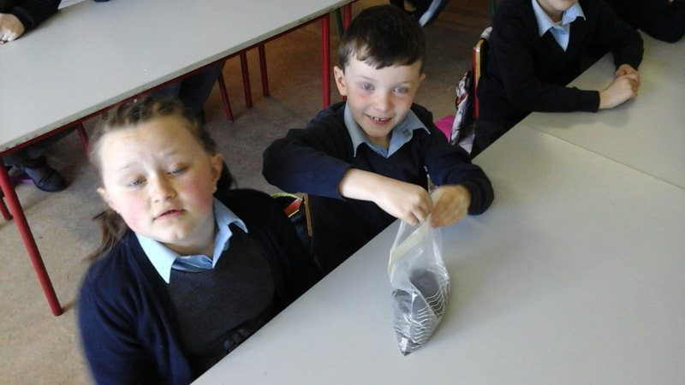
This year the children in 1st and 2nd class have taken charge of the school’s garden. Here they are exploring the seeds and preparing for planting.

Slide 8
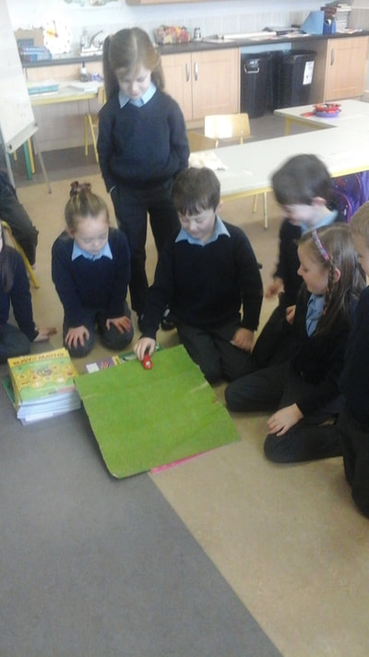
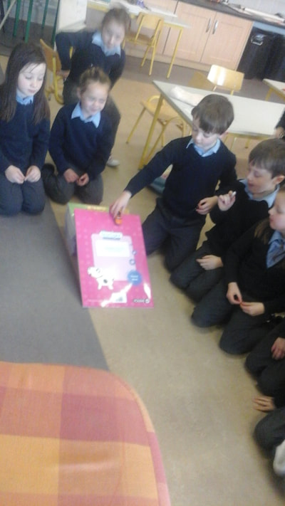
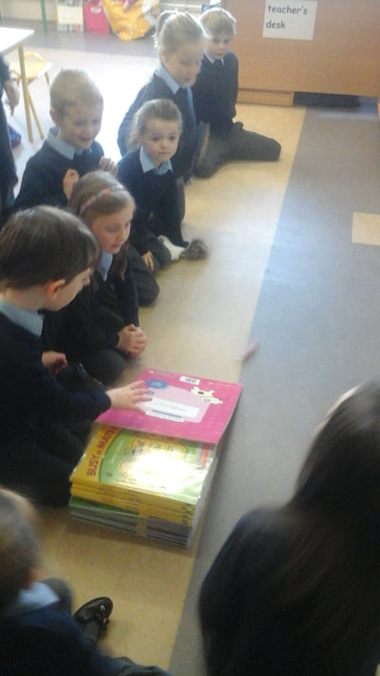
Energy and forces:
The Senior Infants looked at slopes and made a ramp for some toy cars. We watched to see if the car would go faster or slower when we put some carpet on the ramp.

Slide 9
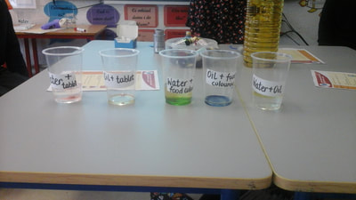
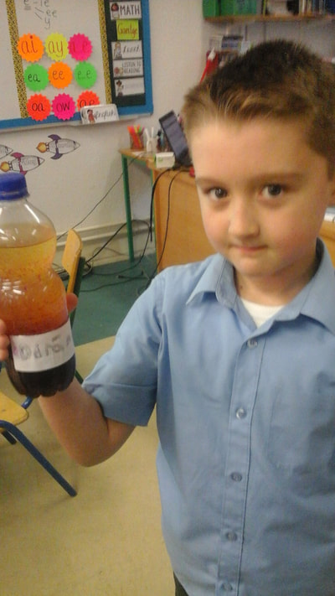
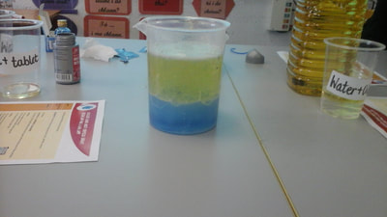
The children in 3rd and 4th class loved observing the reaction when oil and water are mixed but they especially loved dropping the Alka- Seltzer tablets into the mixture and watching the bubbly reaction. They made Lava Lamps for their bedrooms and learned so much Science.

Slide 10
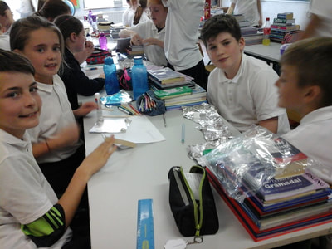
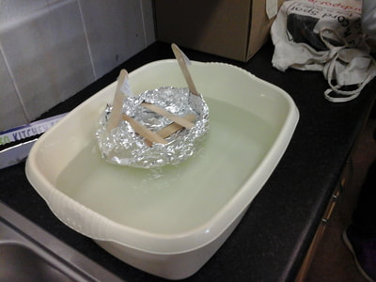
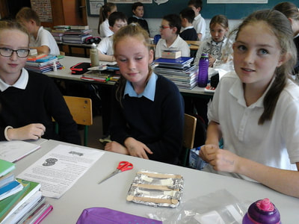
Fifth and Sixth class spent some time learning all about the Titanic. They learned about floating and sinking and the factors that affect boats. They worked as teams to plan, design and make simple boats and test them out in water.

Slide 11
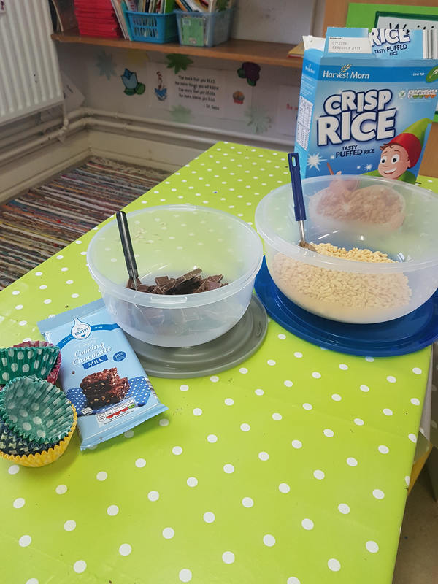
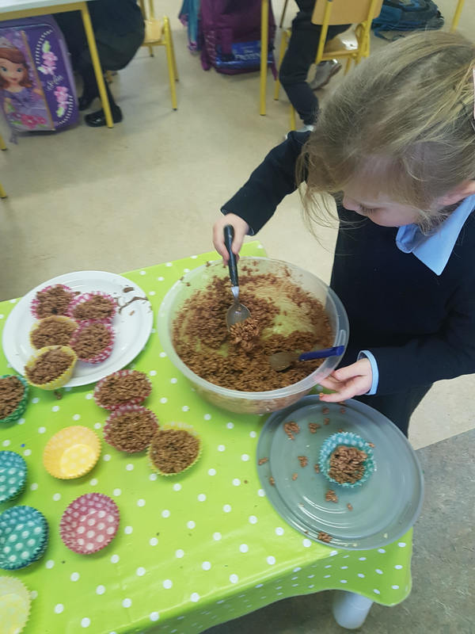
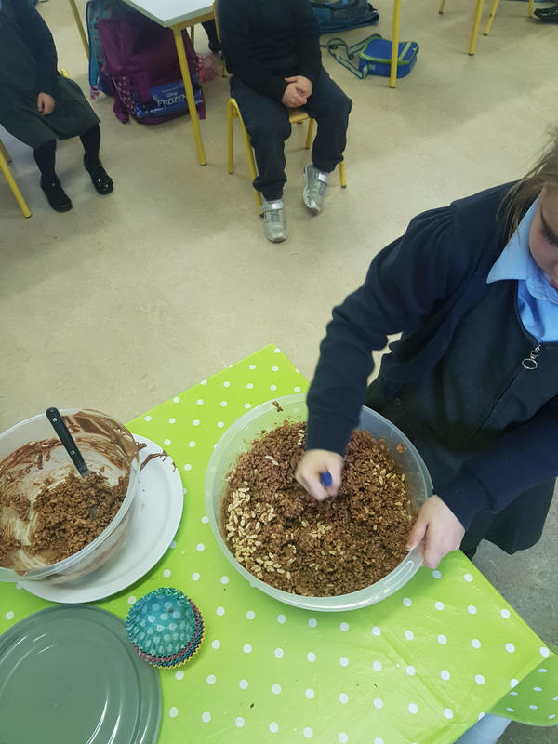
Materials:
Ms. Duggan’s Junior Infants had lots of fun exploring texture, opposites and changing materials. The result was a plate of very tasty rice crispy buns.

Slide 12
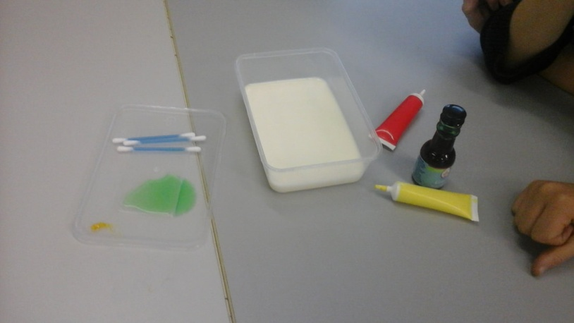
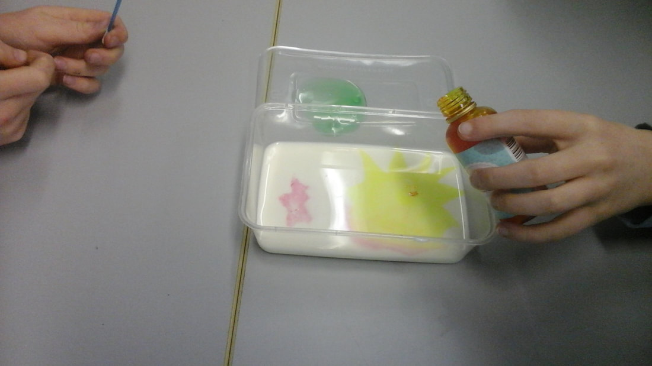
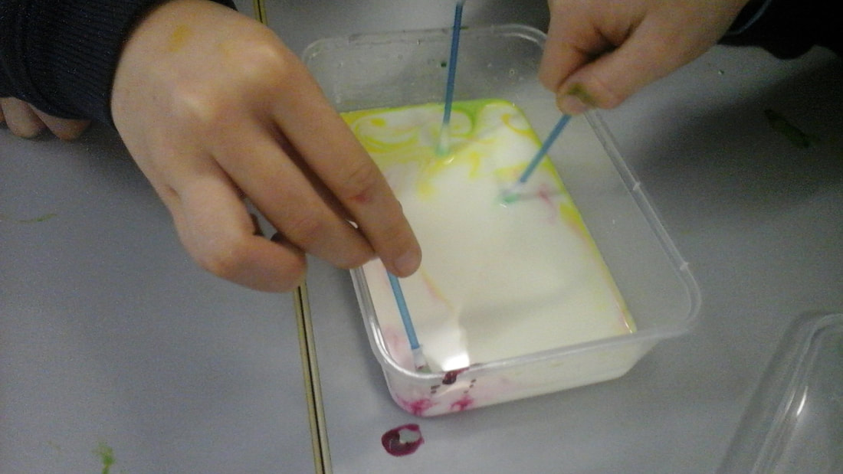
The children in 3rd and 4th class learned all about solids, liquids and gases. The children had great fun making Rainbow Milk. When washing up liquid is mixed to milk, it breaks down the bonds and allows the food colouring to mix throughout creating a rainbow effect.

Slide 13
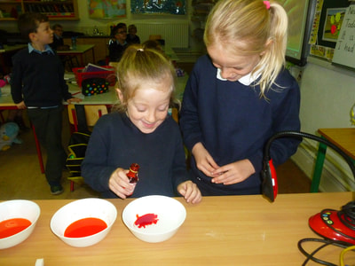
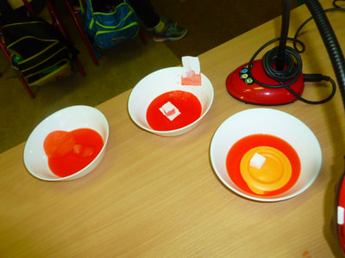
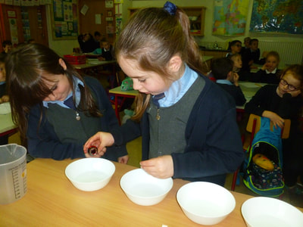
The children in 1st & 2nd class explored damp course. The children carried out a fair test experiment to discover which material worked best as damp course. The children loved watching the moisture travel through the sugar cubes. They discovered that plastic was the most suitable damp course.

Slide 14
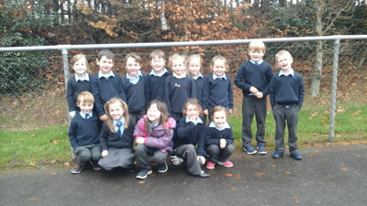
Environmental Awareness and Care:
The children in Senior Infants made bird feeders and hung them on the trees around the infant yard. We even found a bird’s nest whilst hanging them up.

Slide 15
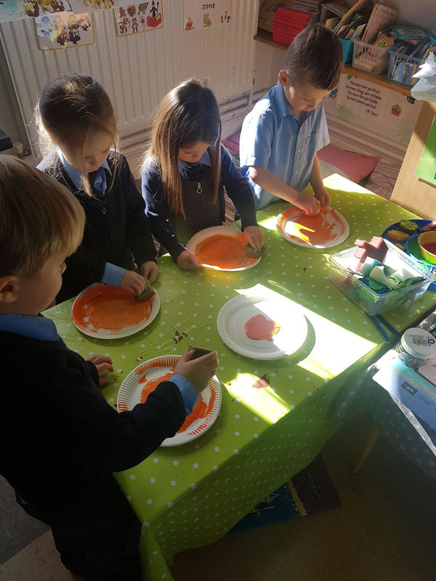
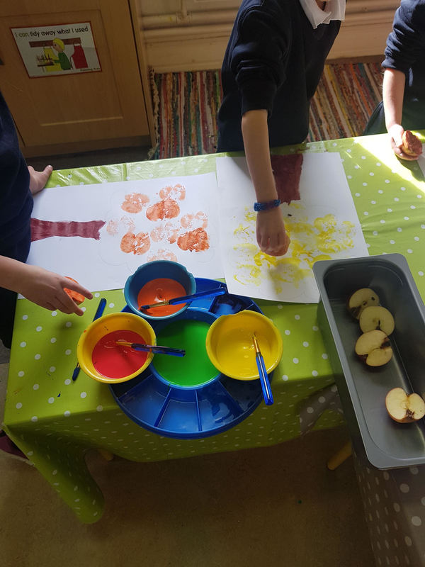
Junior Infants are one with nature! The children in Junior Infants regularly go for walks around our school exploring and learning about the environment, weather and the changing seasons. Following a walk during the season on autumn, the children recreated signs of autumn using apples and paint.

Slide 16
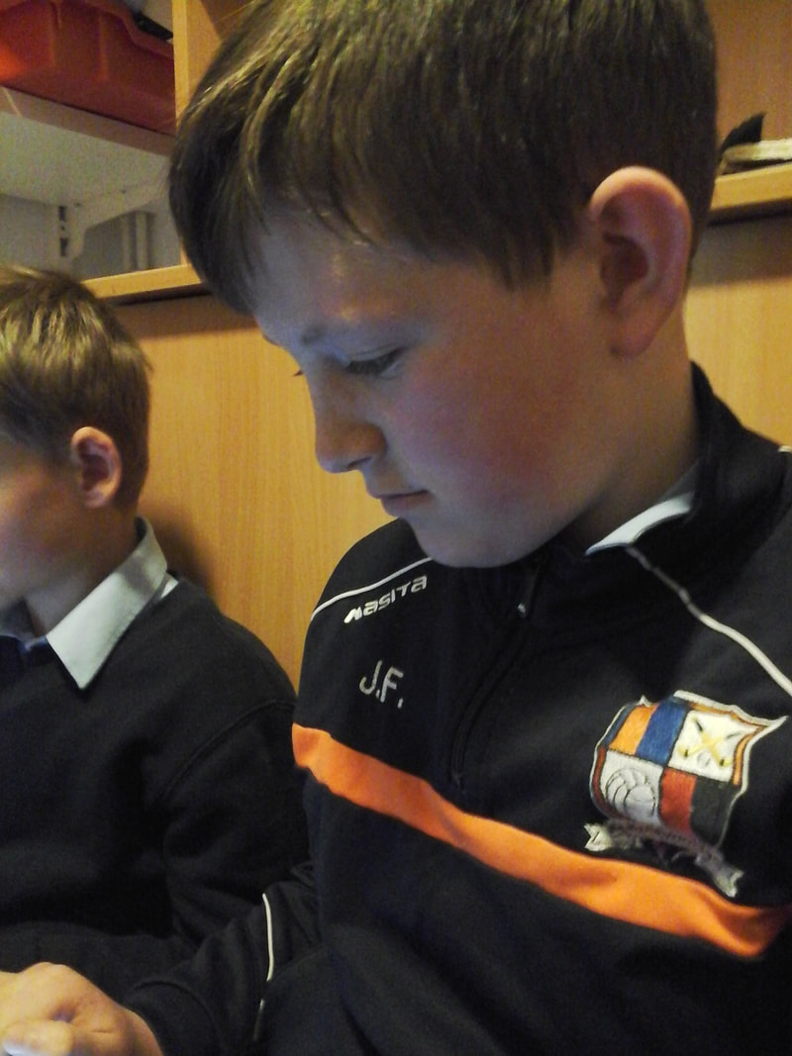
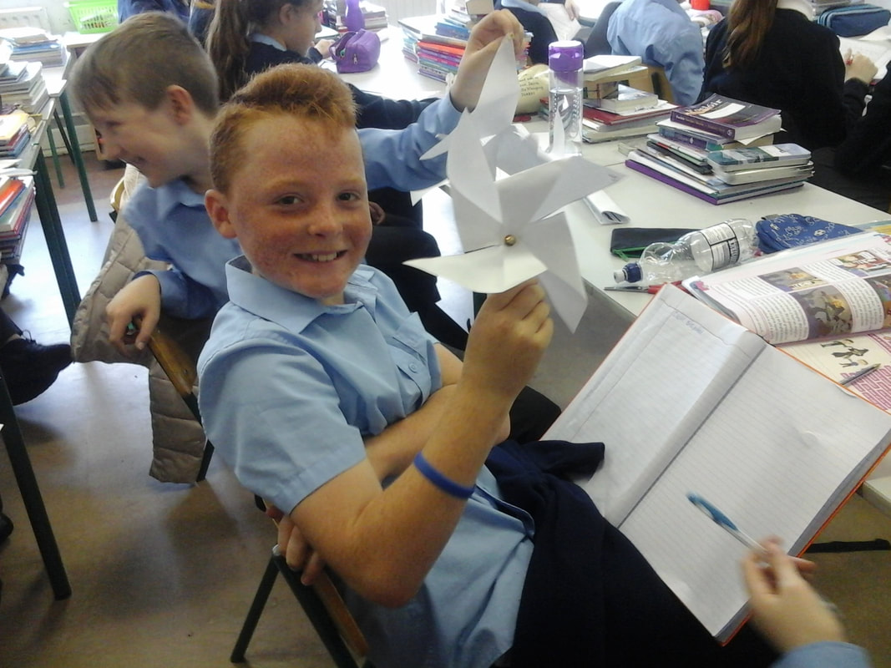
The children in 5th and 6th designed and make windmills as part of their engineering projects but they researched and learned much about green energy and the use of turbines in Ireland to created energy.

Slide 17
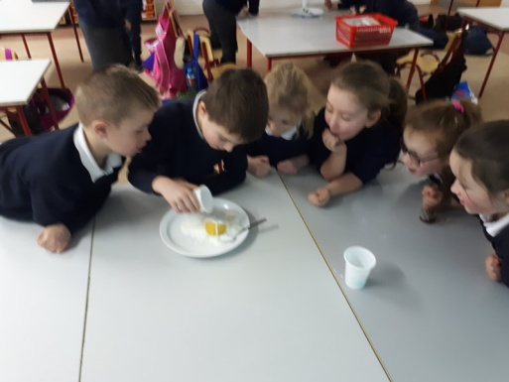
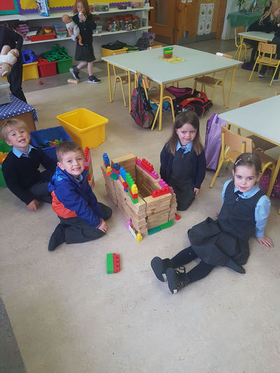
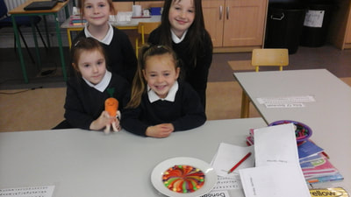
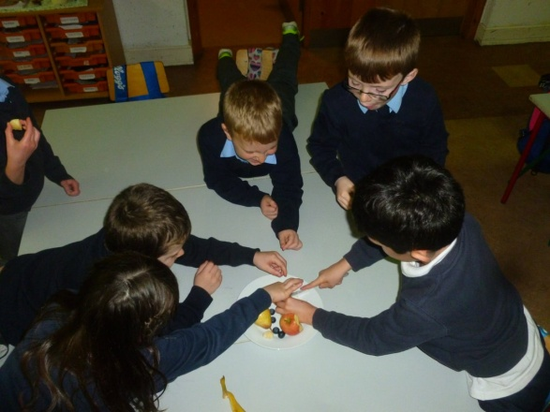
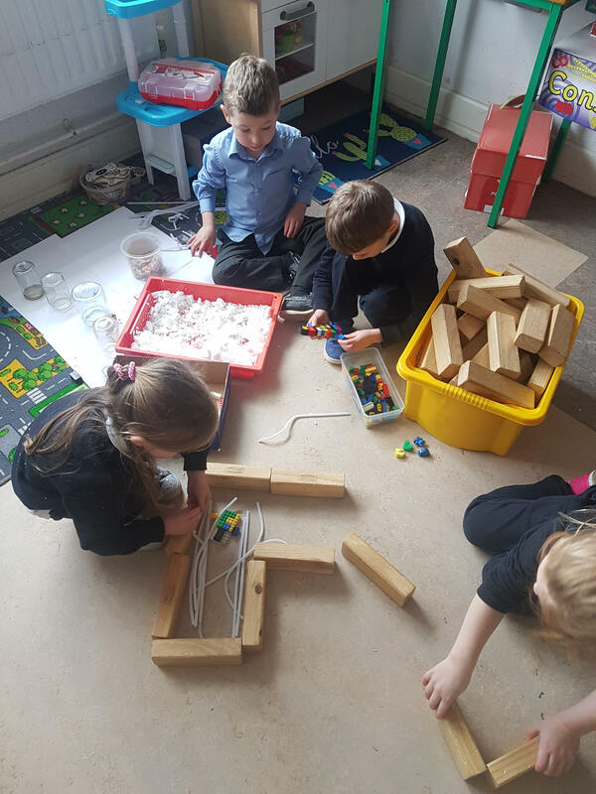
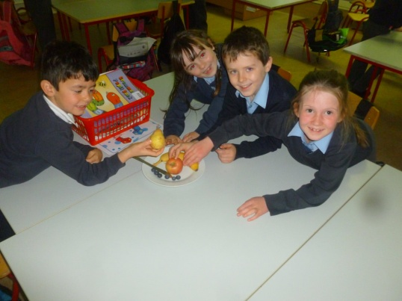
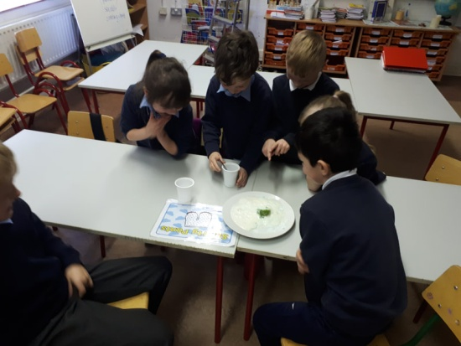
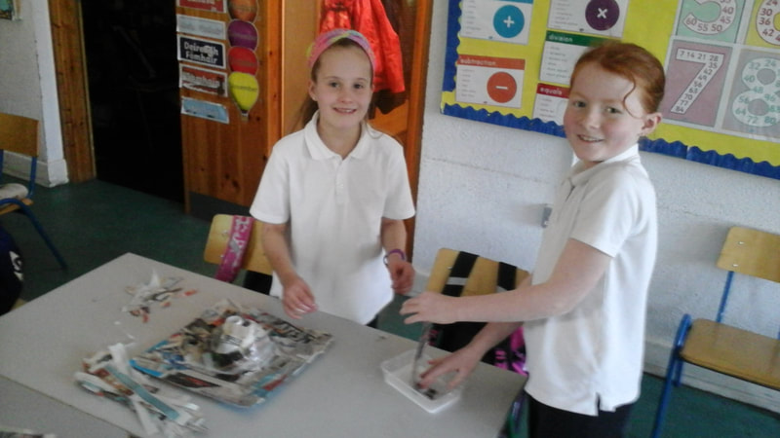
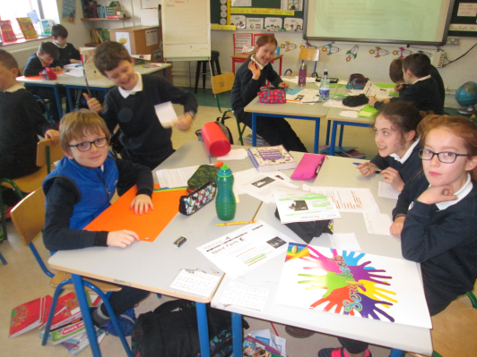
Science Week 2018
The wonderful children of Scoil Teampall Toinne proved to be Super Scientists during Science Week. Take a look!

Slide 18
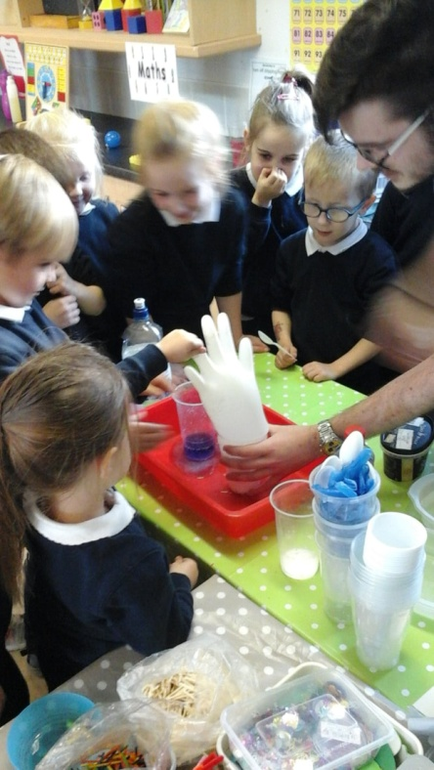
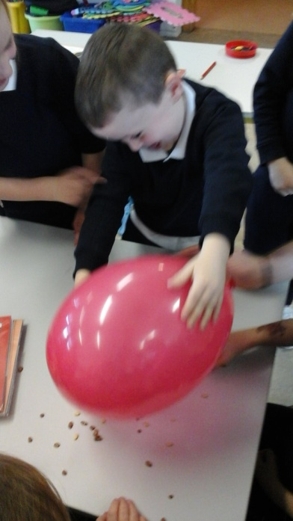
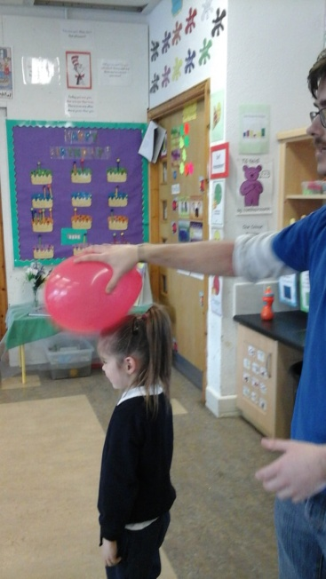
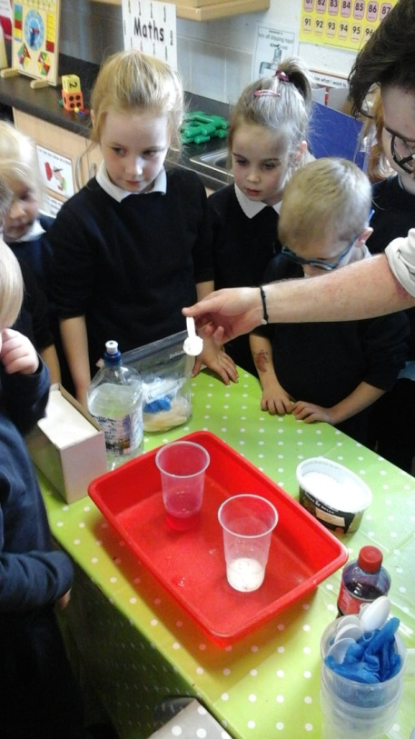
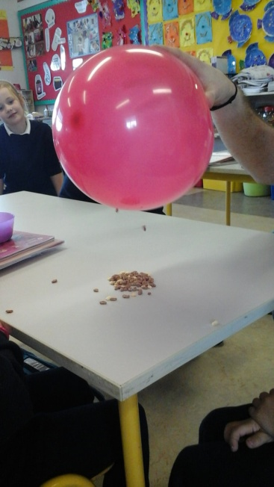
Visit from Lismore Mobile Science Centre to all classes:
Junior Infants
Senior infants also learned about static electricity, acids and based and they made a volcano as well.

Slide 19
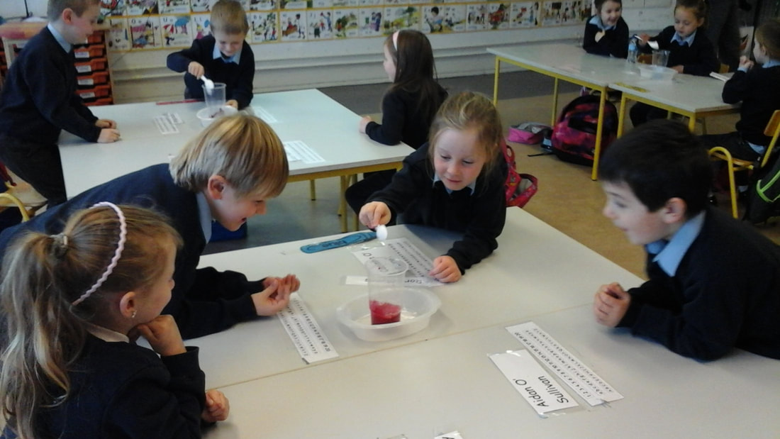
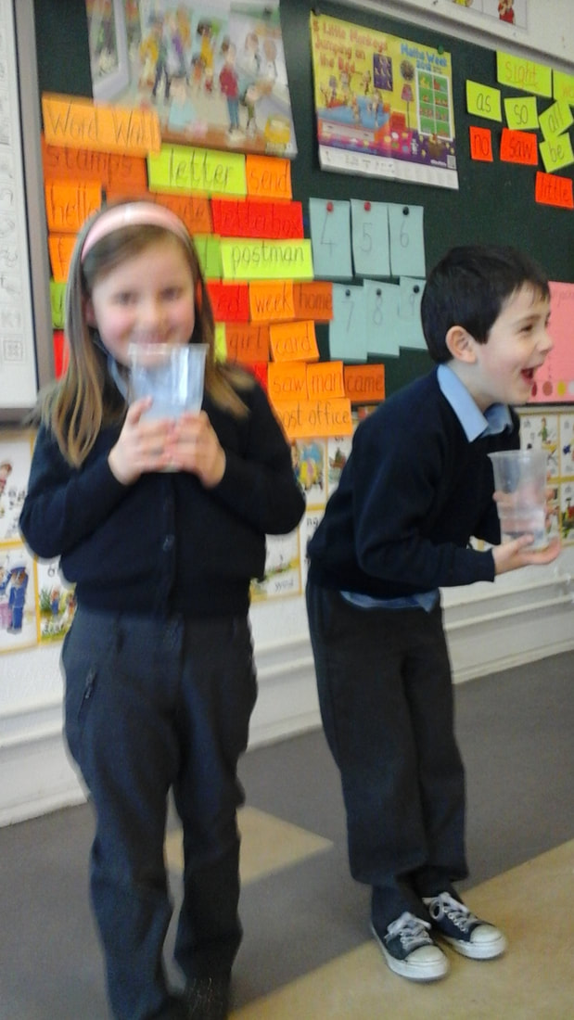
Senior Infants
Senior infants also learned about static electricity, acids and based and they made a volcano as well.

Slide 20
1st & 2nd class: Guts and Digestion
The children had lots of smelly fun with these experiments. They learned all about the gut and the intestine. They learned how food travels through the digestive system and is broken down to be used to help us to grow and play.

Slide 21
3rd & 4th class: Electricity
First the children learned that electricity is a form of energy and it travels along paths called circuits.
Next the children learned about static electricity.
Then the children learned all about the different types of circuits.

Slide 22
5th & 6th class:
Here a some pics from the Crime Scene investigation workshop. The class worked through a crime using forensic science. They explored fingerprinting / DNA / Chromatology (ink pattern testing). They had to investigate suspect profiles, develop motives, note the possibility of decoy clues and also how a crime scene can be contaminated.

Slide 23
Step Two:
Technology

Slide 24
The children love using technology throughout their lessons. We have Samsung tablets which we use regularly to record our reading and speaking and play it back to improve our learning. Here the children in 3rd and 4th class have recorded each other speaking as Gaeilge and they listened back to it afterwards to improve their speaking for the next time.

Slide 25
We took part in Internet Safety Day with every class receiving online safety talks!

Slide 26
Product design using materials
The wonderfully talented children in 1st & 2nd class designed and made robots from recyclable materials they found at home. The children had great fun and even came up with names for their robots. The children in 3rd & 4th class also made volcanoes using everyday materials they collected at home and at school. Have a look!

Slide 27
Use electronic components to build simple circuits

Slide 28
Step Three:
Engineering

Slide 29
Design and make activities: making models
5th and 6th were busy creating windmills as part of their discovery of energy and renewable energy sources.

Slide 30
Design and make activities: making models
Children at Scoil Teampall Toinne have great fun making models. Some children made their own boats, parachutes and robots.

Slide 31
Design and make activities: making models
Children at Scoil Teampall Toinne have great fun making models. Some children made their own boats, parachutes and robots.

Slide 32
Investigating Engineering

Slide 33
Step Four:
Maths

Slide 34
Take part in Maths Week 2018
The theme of this year's week was 'Maths for All'. Following that theme, all pupils in the school participated in Maths Trails in their class groupings and were assisted by pupils from older classes. Here are some photographs of the children in 3rd and 4th class helping the infants with their maths.

Slide 35
Use Maths in practical ways to help explore and solve real world problems
Senior Infants made a bar chart of all the different coloured coats to see which colour was the most popular.
The boys in 3rd class found using their playground was a great way to identify the differences between lines, angles and shapes.
In 1st & 2nd class, the children use everyday objects to estimate, measure and solve capacity problems.

Slide 36
The children in 1st, 2nd, 3rd and 4th loved playing maths games and visiting each others classrooms. The older children show off their learning by teaching the younger children and showing them how to solve simple puzzles.

Slide 37
We borrowed the amazing Izak 9 Maths resource from the Waterford Teachers’ Centre. It was a huge hit with the children and they showed off some impressive math language, problem solving and reasoning skills.

Slide 38
Stem Showcase
The children in 1st and 2nd class proudly showed off their excellent engineering and creative skills when they presented their robots to the children in the older classes. They spoke with confidence in explaining how they created their robots and the inspiration behind their hard work.

